Slide 1
Data Analytics Capstone Project
History of Data Breaches in U.S
Presented by
Miriam Rodriguez

Slide 2
Data Analytics Capstone
Business and data understanding:
Project overview,
Data description, etc.
Data assessment / transformation / cleaning / integration
Exploratory data analysis and data visualization
Model building
Model evaluation
Final analysis and story telling:
Interpretation of model outputs
Development of managerial and technical implications

Slide 3
Project Overview and Business Purpose
The business purpose was to investigate the history of data breaches in the U.S using Data Science techniques to gather information about data breaches, their impact and trends.
A dataset from an external website was provided for that purpose
Utilized techniques to perform data transformation, cleaning and integration
Performed exploratory data analysis and data visualization to gather insights and answer questions.
Determine the best data model to use for prediction
Explored different data models by building models
Evaluated the performance of each model.
Models were built using unsupervised (topic modeling) and supervised (classification) machine learning techniques.
Final analysis and story telling:
Interpretation of model outputs
Answer business questions
Managerial and technical implications

Slide 4
Data Description and Understanding
Dataset name: Privacy_Rights_Clearinghouse-Data-Breaches-Export.csv
Source: https://www.privacyrights.org/data-breaches (Links to an external site.).
Data Description and FAQ: https://www.privacyrights.org/chronology-data-breaches-faq
Duration of the data: 2005 through 2017

Slide 5
Data Description and Understanding
Data elements/column names
Date Made Public: Date Breach information released to public (date: year, month, day)
Company: Company breached (text)
City: City of breached company (text)
State: State of breached company (text)
Type of Breach: Four-character Breach Type
Type of Organization: Three-character Organization Type
Total Records: Number of records breached (integer)
Description of Incident: Text describing breach (text)
Information Source: Location of database source (text)
Source URL: Location of data source URL (text)
Year of Breach: Four digit year (numeric)
Latitude: Location Latitude (signed numeric long)
Longitude: Location Longitude (signed numeric long)

Slide 6
Data Description and Understanding
Data Breach Types
CARD - Payment Card Fraud: Fraud involving debit and credit cards that is not accomplished via hacking (e.g. skimming devices at point-of-service terminals).
HACK - Hacking or Malware: Hacked by outside party or infected by malware
INSD - Insider: Someone with legitimate access intentionally breaches information, such as an employee, contractor, or customer)
PHYS - Physical Loss: Includes paper documents that are lost, discarded, or stolen (non-electronic)
PORT - Portable Device: Lost, discarded, or stolen laptop, PDA, smartphone, memory stick, CDs, hard drive, data tape, etc.
STAT - Stationary Device: Stationary computer loss (lost, inappropriately accessed, discarded, or stolen computer or server not designed for mobility)
DISC - Unintended Disclosure: Unintended disclosure (not involving hacking, intentional breach, or physical loss i.e. sensitive information posted publicly, mishandled, sent to the wrong party via publishing online, sending in an email, sending in a mailing or sending via fax.
Unknown

Slide 7
Data Description and Understanding
Institution/Organization) Type
BSF - Businesses - Financial and Insurance Services
BSO - Businesses - Other
BSR - Businesses - Retail/Merchant – Including Online Retail
EDU - Educational Institutions
GOV - Government & Military
MED - Healthcare - Medical Providers & Medical Insurance Services
NGO - Nonprofit Organizations

Slide 8
Data assessment, Transformation, Cleaning / Integration
There are 8202 records total.
Checked data information and determined there were data quality issues:
Date Made Public 8202 non-null object
Company 8202 non-null object
City 5682 non-null object
State 8134 non-null object
Type of breach 8202 non-null object
Type of organization 8202 non-null object
Total Records 8164 non-null object
Description of incident 8199 non-null object
Information Source 8148 non-null object
Source URL 2792 non-null object
Year of Breach 8169 non-null float64
Latitude 8202 non-null float64
Longitude 8202 non-null float64
Based upon above counts, there are missing values for City, State, Total Records, Description, Breach Year

Slide 9
Data Assessment, Transformation, Cleaning / Integration
Data Cleaning
Column name: City
How resolved: Drop column.
Justification: The majority of cities are not provided. All we really need is State.
Column name: State
How resolved: Replace spaces with 'United States'
Justification: Since this value was not provided in the file, the assumption is that the breach was national.
Column name: Total Records
How resolved: Move zeros to null values. Then convert to float to remove zeros, then convert to int.
Justification: This will enable the ability to measure the quantitative impact.
Column name: Description
How resolved: Replace spaces with 'None'
Justification: This value was not provided in the file.
Column name: Breach Year
How resolved: Drop column
Justification: We have date with year with no empty values so do not need this field
Remove the following fields as they are not needed:
Information Source
Source URL

Slide 10
Data Assessment, Transformation, Cleaning / Integration
Created new columns with assigned numerical values so that these would be picked up by histograms and correlations. Added _CAT to column names.
Breach Type
Organization Type
State
Converted values of all numerical columns to integers
Removed all non-US states from file. Total records reduced to 8177
Renamed several columns
Converted Date of Breach to Year only so now it becomes Breach Year replacing the one dropped. It had values in every record where the original one did not.
Integrated GDP from another file for normalization
Created new file for just longitude and latitude columns and removed them from the breach file.
Wrote cleaned breach file.

Slide 11
Exploratory Data Analysis and Data Visualization
Basic Statistics and Visualization
‘Describe’ for columns with object types will provide statistical results as follows:
Breach Year:
count 8177
unique 14
Top 2014
freq 887
The largest number of breaches occurred in 2014.
There are 14 years
Total record count is 8,177

Slide 12
Exploratory Data Analysis and Data Visualization
Basic Statistics and Visualization
In order to answer business questions, need certain statistics:
To get counts: Statistical commands such as ‘df.groupby(['Breach_Year']).size()’ will provide counts for each group within a column.
Did this for Breach Type, Organization Type and State.
Created Histograms for each numerical column
(histograms in next slide)

Slide 13
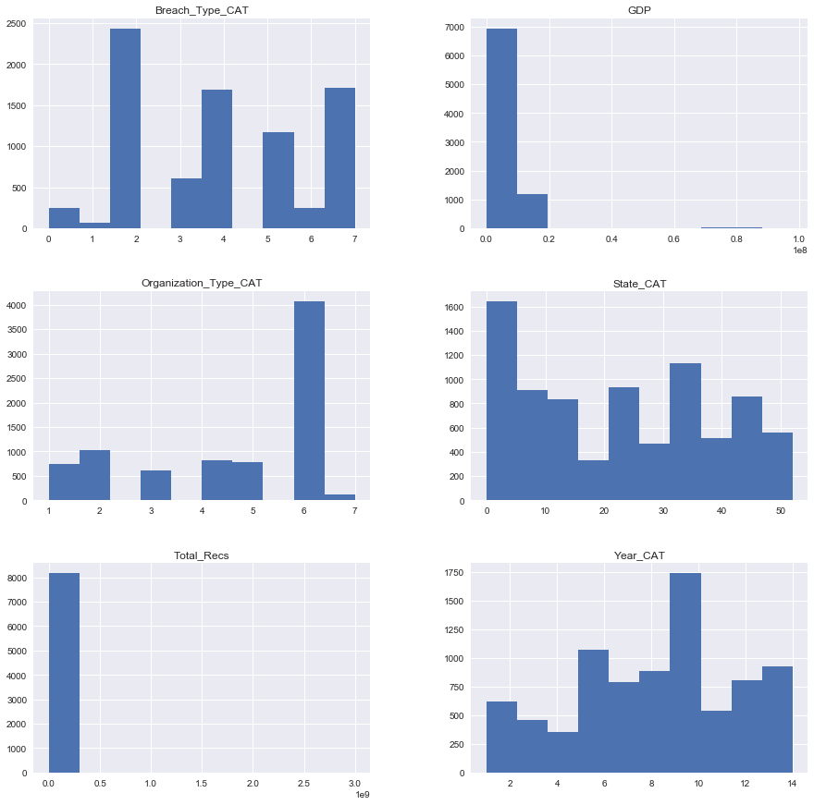
Exploratory Data Analysis and Data Visualization
Basic Statistics and Visualization

Slide 14
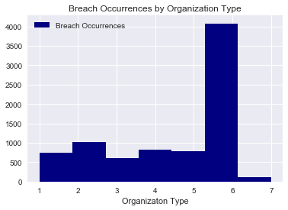
Exploratory Data Analysis and Data Visualization
Basic Statistics and Visualization- Organization Types
Legend for Organization Types:
1 BSF - Businesses - Financial and Insurance Services
2 BSO - Businesses - Other
3 BSR - Businesses - Retail/Merchant – Including Online Retail
4 EDU - Educational Institutions
5 GOV - Government & Military
6 MED - Healthcare - Medical Providers & Medical Insurance Services
7 NGO - Nonprofit Organizations
Shows Medical has the largest number of breaches
Counts by category
1 - 746
2 -1028
3 -615
4 - 818
5 - 775
6 - 4077
7 - 118

Slide 15
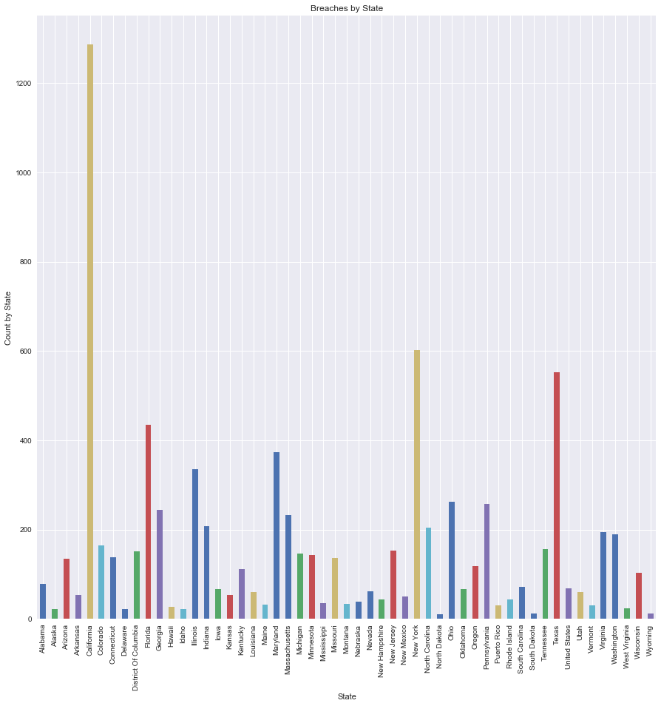
Exploratory Data Analysis and Data Visualization
Basic Statistics and Visualization- State CA top breaches

Slide 16
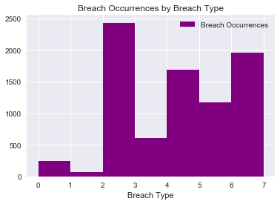
Exploratory Data Analysis and Data Visualization
Basic Statistics and Visualization- Breach Types
Legend for Breach Types:
1: CARD - Payment Card Fraud:
2: HACK - Hacking or Malware
3: INSD – Insider
4: PHYS - Physical Loss
5: PORT - Portable Device
6: STAT - Stationary Device
7: DISC - Unintended Disclosure
0: Unknown
Top Breach Type is ‘HACK’
Counts:
CARD 68
DISC 1708
HACK 2431
INSD 609
PHYS 1691
PORT 1172
STAT 249
UNKN 249

Slide 17
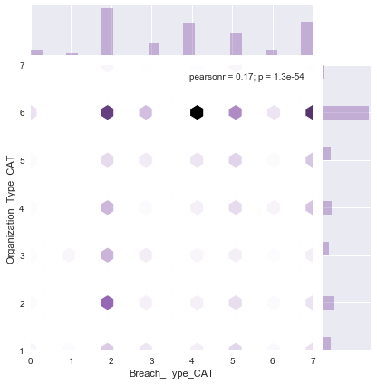
Exploratory Data Analysis and Data Visualization
Basic Statistics and Visualization- Breach X Organization Types
Organizations Y
1 BSF - Businesses - Financial and Insurance Services
2 BSO - Businesses - Other
3 BSR - Businesses - Retail/Merchant –
Including Online Retail
4 EDU - Educational Institutions
5 GOV - Government & Military
6 MED - Healthcare
7 NGO - Nonprofit Organizations
Breach X
1: CARD - Payment Card Fraud:
2: HACK - Hacking or Malware
3: INSD – Insider
4: PHYS - Physical Loss
5: PORT - Portable Device
6: STAT - Stationary Device
7: DISC - Unintended Disclosure
0: Unknown
Shows Medical with the most breaches, Especially Hacking and Physical Loss

